Slide 1
Updating the System of National Accounts to Reflect the Role of Digitalization
Richard Heys (ONS)
Nicola Massarelli (Eurostat)
John Mitchell (OECD)
Dylan Rassier (BEA) Marshall Reinsdorf (IMF)
Erich Strassner (BEA)
Jorrit Zwijnenburg (OECD)
Paper prepared for the IARIW Digital Session on the SNA Update
Views expressed are those of the authors and should not be attributed to any organization, including the IMF, Eurostat, OECD, BEA, or ONS.

Slide 2
Motivation
Digitalization is transforming production processes, products for businesses, and creating new consumption options for households. As digitalization becomes more common in economic activity, the relevance of macroeconomic statistics depends on the ability to adapt the SNA and develop supplemental frameworks to meet the evolving needs of policymakers and other users.

Slide 3
Research Agenda on Digitalization for the Update of the SNA
A Framework for a satellite account on the Digital Economy
Price and volume measurement affected by digitalization
Recording and valuation of data in National Accounts
Treatment of “free” products
Cryptocurriences

Slide 4
Framework for a Satellite Account on the Digital Economy

Slide 5
Digital Supply-Use Tables and High-Priority Digital Economy Indicators
SUTs underpin estimates of GDP, this work builds on these conventional SUTs, that are already compiled by most statistical offices.
Time-series indicators on digital activity in the economy that are consistent with already published macro-economic indicators.
Digital economy satellite accounts and/or supplemental tables as an ideal mechanism to give better visibility to this sector.

Slide 6
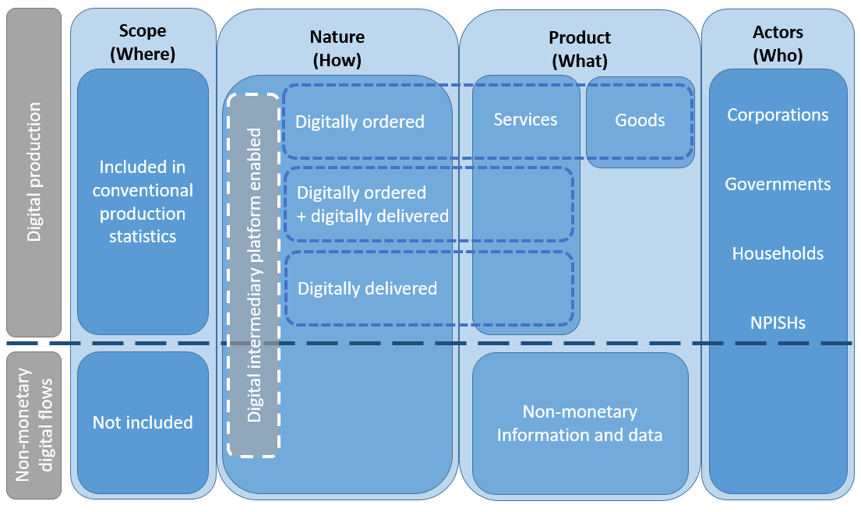
Conceptual Framework for Measurement of the Digital Economy
Source: OECD, adapted from OECD-WTO-IMF (2019).

Slide 7
Digital Supply-Use Tables Framework
The final framework includes the following extensions to the conventional supply-use tables:
  Additional rows, under each product, separating the different transactions types.
  Additional digital product aggregations and lower level products to assist in answering specific user questions.
  Additional product rows representing products currently outside of the core SNA.
  Additional columns to represent the new digital industries, units are aggregated based on their shared characteristics.
  Additional columns allowing for the representation of services that have been digitally delivered.

Slide 8
Next Steps
Many countries have expressed that they do not currently have the capability to produce all estimates in the table.
The Digital SUTs are partly designed to act as road maps that help to motivate the development of new data sources. Even partially completed tables will significantly help to fill the current information gaps.
Digital SUTs will help to provide momentum for all countries in fostering the compilation of internationally comparable data on the digital economy.
Some initial indicators will be targeted first.
  Output, Gross Value Added (GVA) and its components, of digital industries.
  Intermediate consumption of Digital Intermediary Services (DIS), Cloud Computing services (CCS) and total ICT goods and digital services.
  Expenditures split by nature of the transaction, includes estimates of digital trade.

Slide 9
Price and Volume Measurement Affected by Digitalization

Slide 10
Prices and Volumes
Volume measures (Real GDP) are typically calculated by deflating nominal values with a price index
Digitalization raises questions about the ability of existing methods to properly measure both:
  Nominal values—capturing the value of digital goods and services in a timely fashion, and
  Price indexes—properly accounting for
    Quality change
    The new ways that goods and services are delivered to final user
Notes:
Get from introduction to draft guidance

Slide 11
Nominal Values
Traditional surveys used to collect nominal GDP might miss or misclassify the output of digital products.
Countries are encouraged to consider:
  More-frequent updates of traditional surveys to rapidly fold in new entities
  Alternative data sources to cover areas missed in traditional surveys.
    Establishment surveys will miss sharing economy activity. Household surveys may need to be expanded for this purpose.
    Third-party market research firms that collect the data for providers of new digital products
  Other novel ways to fill in the gaps. For example, in the case of globalization of production:
    Where producers are foreign entities, it may be most efficient and effective for the international organization or national statistical agency in the territory in which the platform or provider is located to collect the relevant data from them
    Countries could look to domestic estimates with substitute mirror trade data for particular categories produced by the host NSO in that territory
Notes:
Issue: possibility that spending on digital goods and services is not picked up in traditional surveys and data sources or is misclassified
Most of the businesses which produce digital products have complex and nontraditional legal structures and business models. This makes classifying the economic activity and agents very challenging. (digital intermediaries)
There are important questions about where some of the economic agents providing the final services which may be ‘digitally-enabled’ are located vis-à-vis the production boundary.
Large proportions of the economic activity are with economic agents in different countries that are classified as nonresidents in the national accounts. As a result, their economic activity is out of scope of business surveys of the territories in which they operate.
One, a typology of digital intermediary platforms may need to be developed to facilitate their classification and the subsequent development of recommendations on how to classify and record their transactions in the national accounts.
Household surveys may need to be expanded to include questions on household production.
It may be most efficient and effective for the international organisation or national statistical agency in the territory in which the platform or provider is located to collect the relevant data from them.
In principle, a variety of traditional and emerging data sources are available to derive the current-price output of digital products. These include economic censuses, enterprise surveys, household surveys, special surveys targeted at specific digital products and web-scrapped data from relevant third-party data providers.
As an alternative, national statistical agencies can consider collaborating with specialized thirdparty market research firms to collect the input data for digital intermediary platforms and providers of new digital products and then make the necessary adjustments before using these data for compiling national accounts. Also, countries could look to substitute mirror trade data
The choice of which data source to use would largely depend on the amount of resources available to national statistical agencies and whether the units providing the digital products are within the scope of surveys. Special regular surveys would most likely require more resources. On the other hand, existing surveys may not be disaggregated enough to directly capture estimates of digital products and activities. As a result, estimates of digital products and activities are obtained indirectly using various assumptions. One solution is to consider expanding the level of detail in existing surveys to get direct estimates of digital products and activities. Also, many economic agents providing the digital products are not incorporated or registered in the territories where they conduct their business. As a result, they may be out of the scope of the business surveys of the territories in which they operate. One solution is for the international organisation or national statistical agency in the territory in which the economic agent is located to collect the relevant data from them for sharing with other data compilers. In this respect, data sharing arrangements may need to be developed or existing ones enhanced and strengthened.

Slide 12
State of Play for Price Indexes
New models of existing digital goods and services
  Quality adjustment generally is possible
  Hedonics is the gold standard
Entirely new digital goods and services
  Quality adjustment is difficult, but
  Early introduction of new technology products in price indexes is important, as many technology products display rapidly falling prices in their early years in the market.
Traditional goods and services affected by digitalization
  The increasing digital content and attendant quality improvements in traditional goods also requires quality adjustment (e.g., cars)
  New ways of providing traditional services requires special handling, though there is no consensus on how this is best done (outlet substitution bias)
    UBER, AirBnB
    Retail services: online purchases

Slide 13
Price Indexes
Across all the areas outlined where fast-moving quality change is a result of the process of digitalization, countries are advised to review:
The frequency with which they update their survey collections, to ensure they continue to capture the rapidly changing nature of these product classes and
The level at which data is collected and deflation takes place to create volume estimates.
  Often, being able to deflate at more granular levels within the product classification and weighting these at more aggregated levels will be an important component of delivering more robust estimates.

Slide 14
Recording and Valuation of Data

Slide 15
Characteristics of Data
Data is produced and included in the SNA production boundary
Distinguished from underlying non-produced observable phenomena
Focus on digital data (non-digital data exist but considered marginal)
Long-lived data is an asset (therefore also included in the SNA asset boundary)
Data is subject to economic ownership, valuation and depreciation
Short-lived data are also produced but not an asset (not inventories or valuables)
Notes:
Digital data has the potential to generate much larger valuations and greatly influence the efficiency and output of production due to its ability to be easily processed and to be sold/leased/purchased.

Slide 16
Definitions under Consideration
Database [from 2008 SNA (10.112)]
Databases consist of files of data organized in such a way as to permit resource-effective access and use of the data. Databases may be developed exclusively for own use or for sale as an entity or for sale by means of a license to access the information contained.
Data
Data is information content that is produced by collecting, recording, organizing and storing observable phenomena in a digital format, which can be accessed electronically for reference or processing and from which their owner(s) derive economic benefits by holding or using it.
Data as an asset
Data from which their owner(s) derive economic benefits by using them in production for at least one year (long-lived data) are fixed assets.

Slide 17
Definitions under Consideration
Short-lived data:
Data from which their owner(s) derive economic benefits by using them in production for less than one year is to be considered as intermediate consumption when it is purchased from third parties, or as the product of an ancillary activity, i.e. an integral part of the primary activity, when the production is taking place within the same unit.
Observable phenomenon:
An observable phenomenon is the occurrence of a singular event or piece of information. They can result from events, interactions and participation by actors in the economy. They can come into existence through the actions of, or information about, a single person; as the direct result of an interaction between two parties; or as a by-product of production.
In general they are non-produced and have zero or negligible value
They are outside the SNA production and asset boundaries

Slide 18
Recording Data as an Asset
Ideal recording: create a new specific fixed assets category under ‘Computer software, data and databases (AN1173)’
  Conceptual rationale: give relevance to data as a separate fixed asset, thus highlighting its importance in today’s economy
Alternative recording: expand the scope of databases in capital formation, to include the costs to produce or acquire data
Practical rationale: it may not always be possible to separate the costs of database structure from that of the database content (i.e. data)
Experimental testing in satellite account framework will be important element toward making final recommendations, including valuing data through sum of costs for own-account data and market value for purchased.
Notes:
Whatever the chosen option, the conceptual distinction between data and databases is useful to bring clarity and should be included in the next version of the SNA.

Slide 19
“Free” Products

Slide 20
Background
A guidance note on “free” products is still pending. The Subgroup has so far considered three categories of “free” products:
“Free” assets are intangible fixed assets that have been produced with inputs of labor and capital for own use in production and for use by others in production at no cost or at a cost that is significantly less than the cost of production.
    Primarily includes software.
“Free” content includes all digital and non-digital content that is provided to households without explicit charge in exchange for households consenting to advertising, marketing, or sales messages.
    Ruled out as an option by the Subgroup.
“Free” digital services includes digital content that is provided to households without explicit charge in exchange for access to personal observations that become data that enrich the effectiveness of advertising, marketing, or sales messages.
    Usually made possible by digital platforms.
The Subgroup generally agrees “free” products should be limited to a satellite account.

Slide 21
Bartering Personal Observations for “Free” Digital Services
A barter treatment increases measured value-added for company 1 (the platform) only as a result of the new data asset.
The barter treatment reflects households producing own-account services using capital services as intermediate consumption, which results in value-added in a household account outside the SNA boundaries.
Company 1
Consumer
Company builds intangible software asset
1
2
Consumer consumes digital services
Consumer possesses own-account digital personal observations as a non-produced asset
Company builds database asset using personal observations
4
3
5
Company 2
Purchases database services as intermediate consumption
Notes:
The Subgroup has considered a number of options for recording “free” products, and the current state of discourse focuses on these two perspectives: 1) bartering personal observations for “free” digital services and 2) measuring “free” digital platforms.
The figure reflects a multi-sided market that’s composed of a platform company (i.e., company 1), a household (i.e., consumer), and a third-party company (i.e., company 2).
Series of transactions:
The platform company develops an intangible software asset.
Households consume digital capital services from the software asset.
Households provide personal observations in exchange for the “free” digital services.
The platform company develops a database asset using personal observations
A third-party company purchases advertising services with cash.

Slide 22
Measuring “free” Digital Platforms
Recognizes a bundle of products offered in which the provision of lower-priced products are subsidized by higher-priced products.
The bundle generates revenue that is commensurate with the amount of production taking place in the economy.
Correcting prices that have been subsidized without simultaneously correcting marked up prices would lead to mismeasurement.
SNA treatment of “free” digital platforms should be the same as traditional bundled products in which a single consumer purchases related products (e.g., telecom carrier + smart phone).
With traditional bundles, consumers fund the subsidies they receive.
With platforms, users pay for services through a chain of transactions.
  Collection of data yields own-account capital formation in information assets.

Slide 23
Differences in Perspectives
Barter perspective:
Proponents: Platform produces unrelated services to more than one customer (e.g., search services in exchange for personal data and enhanced advertising services in exchange for cash).
Skeptics: Platform “free” services have already been paid for indirectly.
Bundled perspective:
Proponents: SNA criteria for a transaction not satisfied because “Free” services are a lure to attract users to the platform so data can be collected (rather than mutual agreement).
Skeptics: Mutual agreement is implied by the household’s mere use of a platform.
GDP changes in response to an additional data asset under either perspective.

Slide 24
Recording of Crypto-Assets

Slide 25
Are all Crypto Assets within the Asset Boundary?
IMF and OECD began drafting guidance on their recording, as they are absent in current statistical manuals … with focus on appropriate definitions.
Crypto assets with corresponding liability:
Yes; these are the result of a financial transaction in which there is a simultaneous creation of an asset and liability
Ownership is well-defined, and they provide economic benefits to holder
Crypto assets without corresponding liability:
  Depends on assessment of ‘mining’ activity (see pending questions)
  Interim guidance:
    Activity is regarded as a form of production
    Value of output is equal to sum of transaction fees and value of ‘new’ crypto assets
    Industry: computer programming activities (Section J - Division 62), possibly in a separate subcategory ‘crypto asset miners’
    Product class: information technology design and development services (CP8314), possibly as a specific subcategory ‘crypto asset services’

Slide 26
Proposed Categorization
(1) Crypto assets acting as general means of payment
(2) Payment tokens
(3) Security crypto assets
(4) Crypto assets acting as a store of value
With a corresponding liability, issued by a monetary authority
With a corresponding liability, not issued by a monetary authority
Without a corresponding liability
With a corresponding liability
Without a corresponding liability
Debt security crypto assets (including utility tokens)
Equity crypto assets
Derivative crypto assets
With a corresponding liability
Without a corresponding liability

Slide 27
Proposed categorization: with corresponding liability
(1) Crypto assets acting as general means of payment
(2) Payment tokens
(3) Security crypto assets
(4) Crypto assets acting as a store of value
With a corresponding liability, issued by a monetary authority: record as ‘currency’ (AF.21); similar to traditional fiat currency
With a corresponding liability, not issued by a monetary authority: record as separate category under ‘currency and deposits’ (AF.2); different from traditional fiat currency, but clearly financial instrument
Without a corresponding liability
With a corresponding liability: Record as separate category under ‘debt securities’ (AF.3)
  Redeemable with the issuer (i.e. convertible into cash or other asset)
  Negotiable (although limited to platform or network) debt instrument
Without a corresponding liability
Debt security crypto assets: Record as ‘debt securities’ (AF.3) with separate category for utility tokens
  Negotiable instruments serving as evidence of debt
  Also includes utility tokens (as they represent a claim on the issuer and can be exchanged peer-to-peer)
Equity crypto assets
Derivative crypto assets
With a corresponding liability: Record as ‘debt securities’ (AF.3)
Not (yet) qualifying as ‘currency and deposits’ (AF.2)
Seem to resemble negotiable instruments serving as evidence of debt
Alternatively, they could be regarded as a form of equity
Without a corresponding liability

Slide 28
Proposed categorization: without corresponding liability
(1) Crypto assets acting as general means of payment
(2) Payment tokens
(3) Security crypto assets
(4) Crypto assets acting as a store of value
With a corresponding liability, issued by a monetary authority
With a corresponding liability, not issued by a monetary authority
Without a corresponding liability: Record as separate category under ‘currency and deposits’ (AF.2)
  There is no corresponding liability, but for fiat currencies this claim is also often just a matter of convention
  They serve the same role of fiat currency
With a corresponding liability
Without a corresponding liability: do not recognize as an asset
Not redeemable with the issuer
Only medium of exchange within platform
Debt security crypto assets (including utility tokens)
Equity crypto assets: Record as ‘equity’ (AF.51); provide holder with residual claim on the assets of issuer
Derivative crypto assets: Record as ‘financial derivatives’ (AF.7); Provide right to buy (or sell) a particular instrument or commodity
With a corresponding liability
Without a corresponding liability (e.g., traditional cryptocurrencies): Record as separate category under ‘valuables’ (AN.13)
Interim guidance to record them as a specific type of valuables (but ongoing discussion)
Can be regarded as an outcome of production
Despite high volatility in their value, they mainly seem to serve as alternative form of investment

Slide 29
Current State of Guidance
Broad agreement, except for cryptocurrencies without corresponding liability, acting as a store of value
Main questions related to this specific category:
  How to account for their creation?
    Are they the result of mining activities?
    Do they “appear” in the same way that fiat currency “appears”?
  Does it make sense to record some of them as non-financial assets even though they are intended as medium of exchange?
  What is the output of miners?
    Cryptocurrencies or validation services?
  How should their output be valued?
    Sum of cost or sum of fees and value of cryptocurrency?
  Who is consuming the relevant output?

Slide 30
Conclusion and Way Forward

Slide 31
Conclusion and Way Forward
Disruptions attributed to digitization are visible everywhere in our personal and professional lives, yet remain a bit hidden in our economic accounting standards and presentations… and the world has changed since the 2008 SNA with the broader use, and emergence of new, digital technologies… While the SNA research agenda Subgroup on Digitalization has made considerable progress since launched in Summer 2019, more debate and consultation is needed… especially so on the recording and valuation of data and the treatment of “free” products likely requiring the most work to reach conclusion.

