Slide 1


Discussion of “Updating the System of National Accounts to Reflect the Role of Digitalization”
AUGUST 2020
IARIW Digital Session on the SNA 2020
Eric Santor
Advisor to the Governor
Bank of Canada

Slide 2
Views expressed are those of the author and not those of the Governing Council

Slide 3


Slide 4

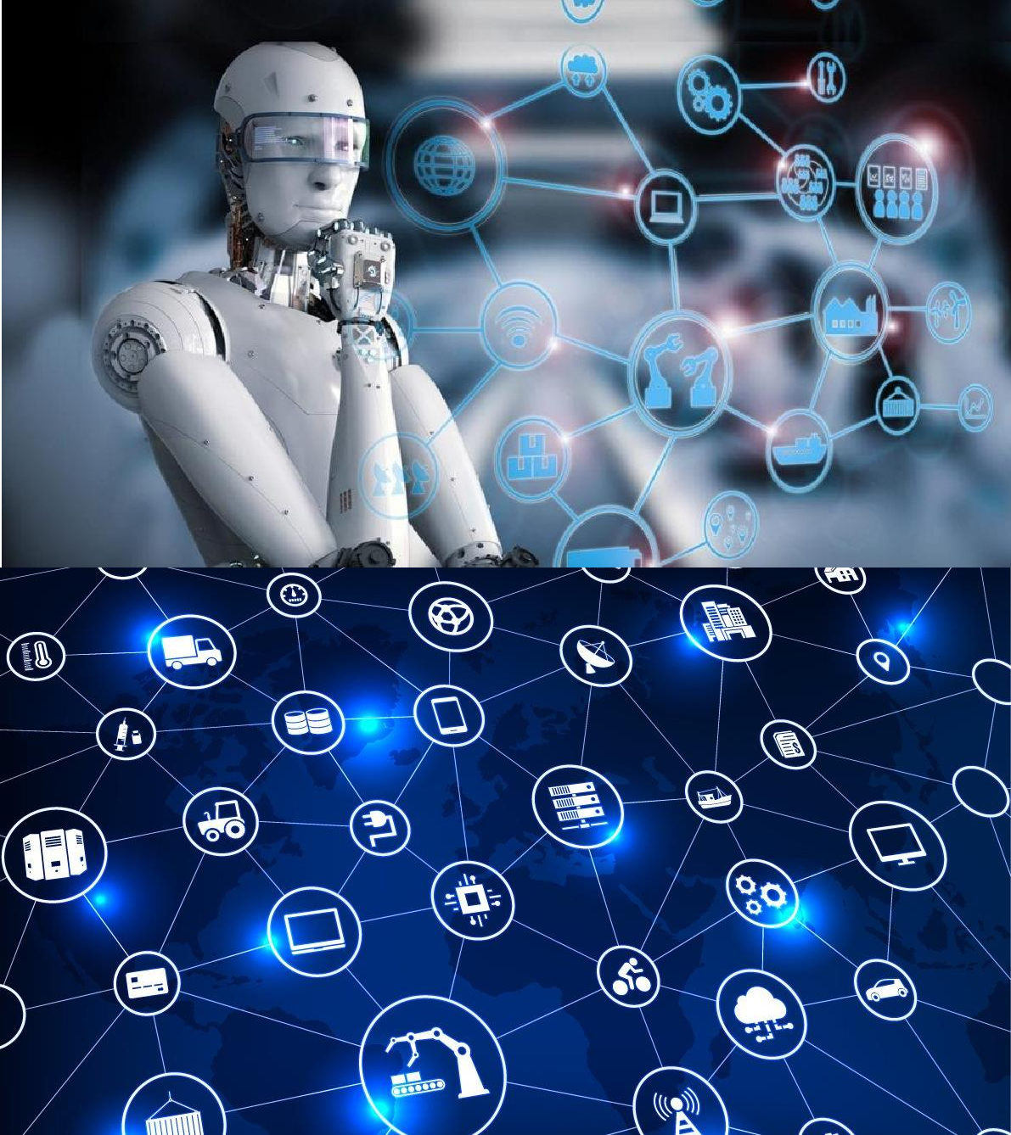
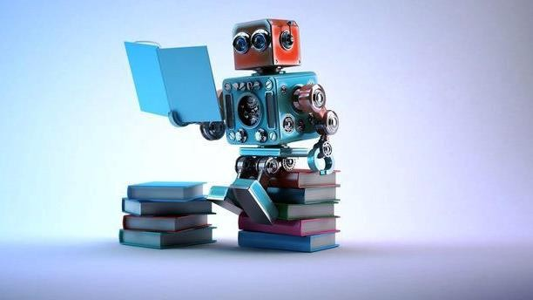

Slide 5
Paper sets out five areas of work
Digital Satellite account
Data
Treatment of free products
Cryptocurrencies
Price and volume measures

Slide 6
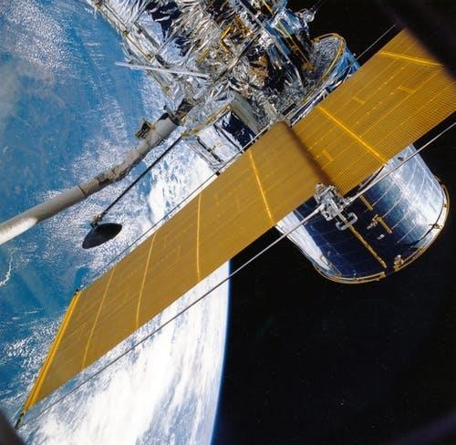
1. Digital Satellite account
Useful approach to look at the relative degree of digitalization
Practical example from Statistics Canada

Slide 7
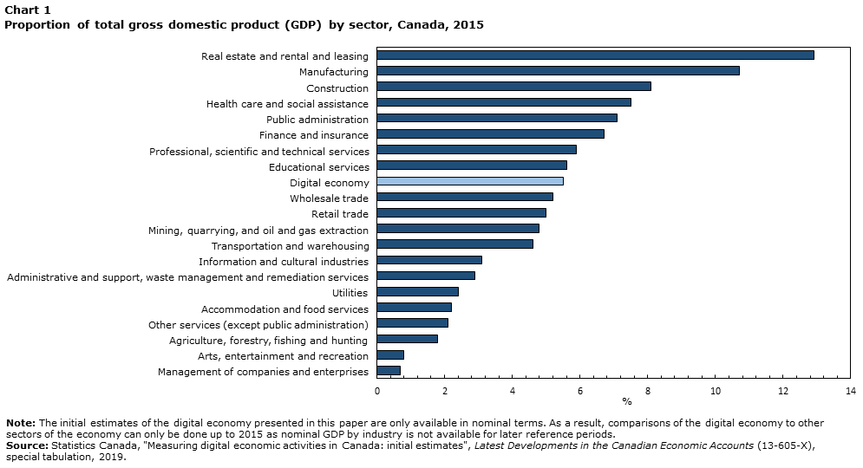

Slide 8
1. Digital Satellite account
Definitions would appear straightforward although they will become blurred as time goes on - will need to evolve
What is a digital firm vs. a non-digital firm?
Link to employment and the gig economy

Slide 9

2. Valuation of data in the SNA
Data matter
Value of data by the market is apparent
Practical example from Statistics Canada

Slide 10
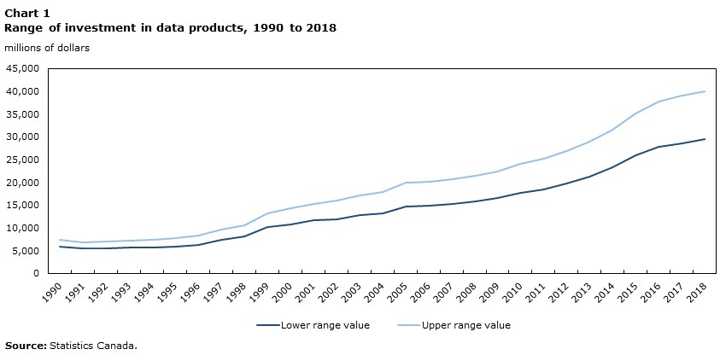

Slide 11
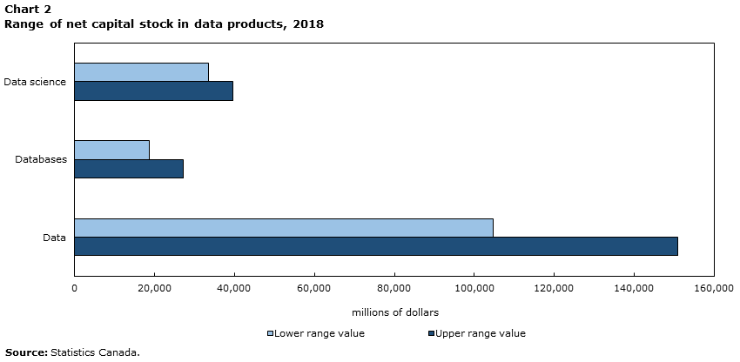

Slide 12
2. Valuation of data in the SNA
Keys issues
  Depreciation
  Increasing returns to scale
  Data ownership (e.g. “open banking”)
  Free data

Slide 13
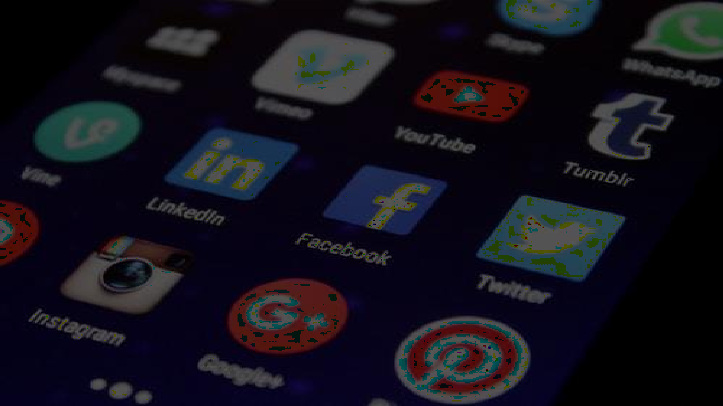
3. Free products and services
Much attention to the value of platforms
  Existing estimates suggest consumes place large value on accessing these platforms
  But we risk double-counting if included
  Value of the data is likely more material

Slide 14

4. Cryptocurrency
Treatment of CBDC intuitive and straightforward
How to value cryptocuurencies poses many serious challenges
Pace of innovation expected to continue

Slide 15

5. Price and volume measurement
Acknowledgement that digitalization will affect a wide range of good and services
Quality adjustment (Byrne et al 2019)
Digital service exports
Health care
Statistics Canada: Informatics professional services price indexes , Telecommunications services producer price indexes, Cloud computing services

Slide 16
6. Other considerations
Collection challenges are important
Use of alternative data sources

Slide 17

Thank you

