Slide 1
Evidence for Middle-Income Trap Non-occurrence in the Light of KLEMS Growth Accounting in Poland
Dariusz Kotlewski - Warsaw School of Economics and Statistics Poland
and
Mirosław Błażej – Statistics Poland

Slide 2
Structure of the presentation:
Part I Basic methodology and specific issues Part II Basic and specific results Part III Analysis related to Middle-Income Trap

Slide 3
Part I
Basic methodology and specific issues

Slide 4
Part I Basic methodology and specific issues :
The fundamental methodology:
Jorgenson, D. W. and Z. Griliches (1967), The Explanation of Productivity Change
Jorgenson, D. W., F.M. Gollop and B.M. Fraumeni (1987), Productivity and US Economic Growth
Jorgenson D. W., M. Ho and K. Stiroh (2005), Information Technology and the American Growth Resurgence

Slide 5
Part I Basic methodology and specific issues :
This methodology has been well summarized in:
Timmer M., van Moergastel T., Stuivenwold E., Ypma G. (Groningen Growth and Development Centre) and O’Mahony M., Kangasniemi M. (National Institute of Economic and Social Research) [March 2007], EU KLEMS Growth and Productivity Accounts, EU KLEMS Consortium.
O’Mahony M., Timmer M. (2009) Output, Input and Productivity Measures at the Industry Level: The EU KLEMS Database. The Economic Journal, 119 (June), F374-F403.

Slide 6
Part I Basic methodology and specific issues :
For Poland KLEMS this methodology has been adapted in:
Kotlewski and Błażej (2016), Metodologia rachunku produktywności KLEMS i jego implementacja w warunkach polskich, Wiadomości Statystyczne 9/2016 – more oriented to Polish audience
Kotlewski and Błażej (2018), Implementation of KLEMS economic productivity accounts in Poland, Folia Oeconomica, 2/2018 – more oriented to foreign audience

Slide 7
Part I Basic methodology and specific issues :
Issue: Capital ICT not extracted from total capital by industries
Solution:
Total ICT amounts distributed by industries proportionally to a chosen structure (ICT services) taken from SUT
Quick depreciation of ICT capital allowed to ignore its older vintages
Therefore, accumulated and depreciated investments over 2005-2010 had given total ICT stock in 2010 (American depreciation rates from KLEMS manuals)
For years before 2010 it was assumed that ICT stocks are in the same proportion to total capital stocks as in 2010
For the following years 2010 was treated as the base year
Works are carried out to shift this initial assessment to 2000-2005 – presently a 3-years shift has been achieved

Slide 8
Part I Basic methodology and specific issues :
Issue: Division into 18 types of labour as required for KLEMS available only as representative sample surveys over firms employing more than 9 persons; total labour market divided only by industries
Solution:
Total labour market structure by industries (14) used as a proportion to adjust upwards the full matrix structure of the Z-12 survey:
Eurostat Transmission
64
18
18
18
14
14
14
34
Z-12

Slide 9
Part I Basic methodology and specific issues :
Total labour market structure by industries (14) used as a proportion to adjust upwards the full matrix structure of the Z-12 survey:
64 Eurostat transmission tables aggregations → 14 NACE-2 labour market corresponding aggregations
64
18
Eurostat transmission
18
18
14
14
14
34
Z-12
Stage one

Slide 10
Part I Basic methodology and specific issues :
Total labour market structure by industries (14) used as a proportion to adjust upwards the full matrix structure of the Z-12 survey:
64 Eurostat transmission tables aggregations → 14 NACE-1/NACE-2 labour market corresponding aggregations
Stage two
64
18
Eurostat transmission
18
18
14/14
14
14
34
Z-12
Stage one

Slide 11
Part I Basic methodology and specific issues :
Total labour market structure by industries (14) used as a proportion to adjust upwards the full matrix structure of the Z-12 survey:
Stage two
64
18
Eurostat transmission
18
18
14/14
14
14
34
Z-12
Stage three
The correct structure enlarged to EU KLEMS 34 industries
thanks to Eurostat transmission 64 industries structure

Slide 12
Part I Basic methodology and specific issues :
Issue: The above mentioned sample surveys available only every 2 years
Solution: linear interpolation
Issue: And available only in NACE 1 or NACE 2 not overlapping each other
Solution: CSO department dealing with the labour market delivered data for 2008 in both classifications
Issue: Short time series – no systematic regular data collection before 2004 (i.e. before the introduction of NACE 1)
Solution: It was decided not to extend KLEMS beyond 2005 in the past

Slide 13
Part I Basic methodology and specific issues :
Additional issue: some data only in ESA’95 or ESA 2010
Solution: Problem concerning only the extraction of ICT capital; growths of stocks of capital by industries diverging only by less than few hundredth of percentage points in some cases; in most cases diverging only by less than few thousandth of percentage points or even less
Ergo: the problem is negligible !!

Slide 14
Part II
Basic and specific results

Slide 15
Part II Basic and specific results:
Computations:
For Poland, because of the unevenness of residential capital it is better not to include it in the accounts, but for international comparisons it is needed
Labour quality can be understood as the difference between:
the growth of hours worked of different (18) labour kinds aggregated with Tӧrnquist quantity index at industry level and the growth of hours worked at industry level, which is the basic approach, or
the growth of labour compensation and the growth of hours worked of different (18) labour kinds aggregated with Tӧrnquist quantity index at industry level, which has been explored independently in Poland
Following slide: comparison of resulting 4 ways of computation

Slide 16
Part II Basic and specific results:
No dwellings
With dwellings
LQ=LC
LG=LR

Slide 17
Part II Basic and specific results:
This version is comparable with the other KLEMS countries

Slide 18
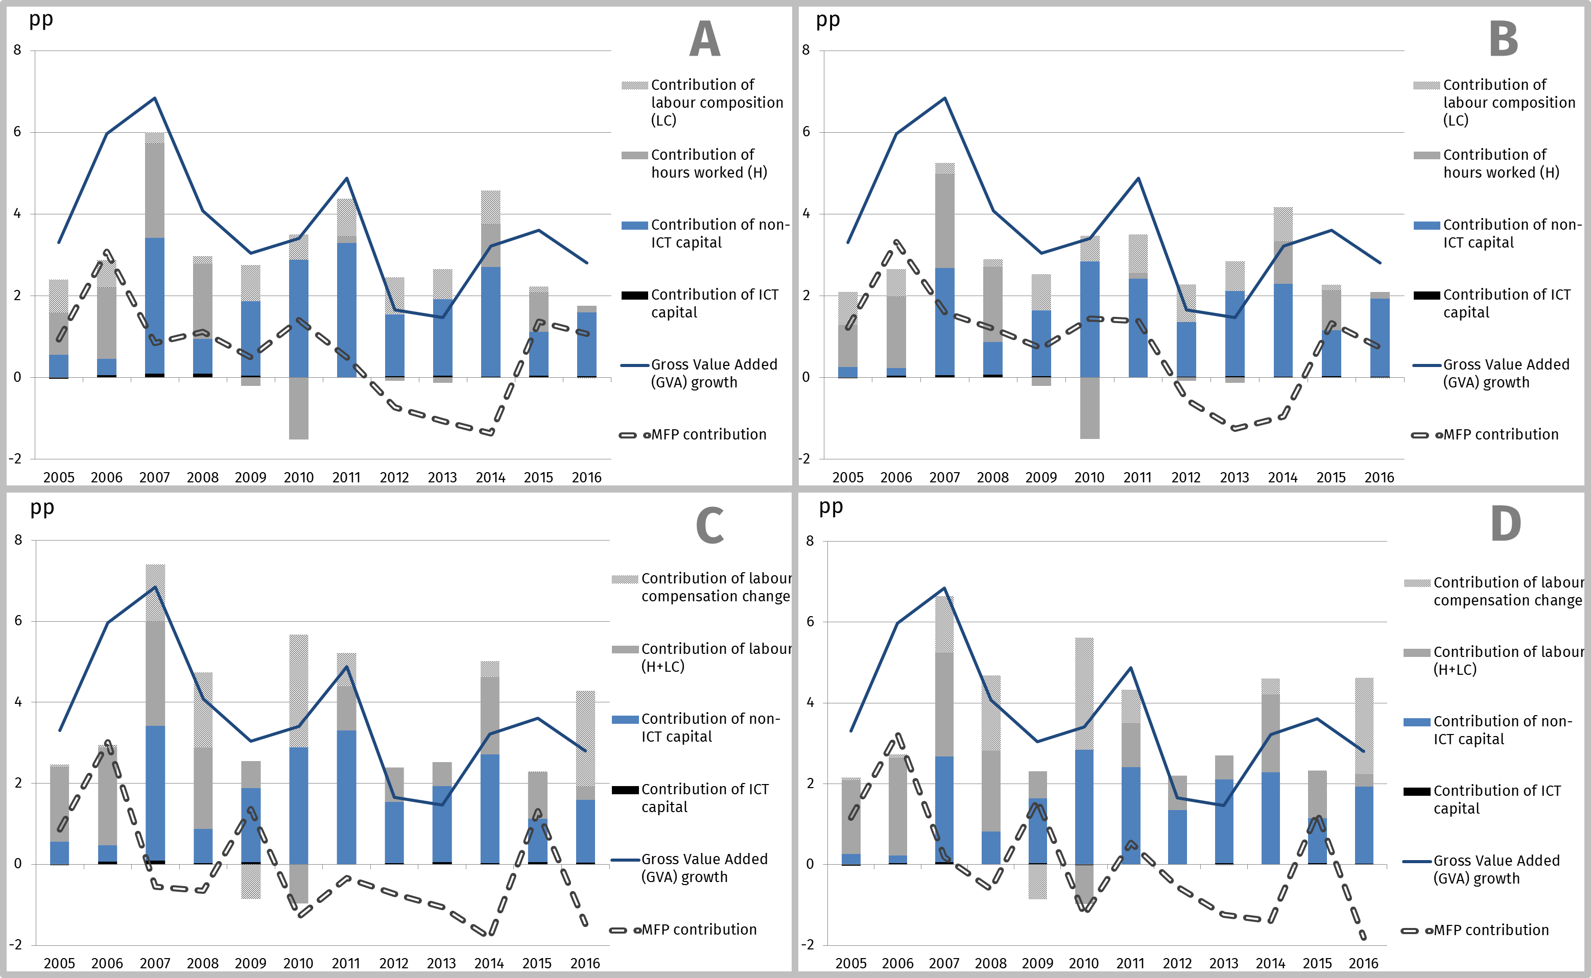
Part II Basic and specific results:
Computing the other versions gives, however, an additional insight, e.g. it can indicate remuneration impulses!

Slide 19
Part II Basic and specific results:
The basic business cycle impact on MFP is reinforced by a reduced contribution of labour originated by a fall in labour supply

Slide 20
Part II Basic and specific results:
The contribution of labour is being replaced by the contribution of MFP !!

Slide 21
Part II Basic and specific results:
This can be a tool problem… but also can be the result of economic elastic reaction to labour policy changes !!

Slide 22
Part II Basic and specific results:
An additional decomposition of the labour factor contribution has been performed for addition insights:
During the Great Recession (2007-2009) the Polish economy reported an unexpected immunity
The specific phenomenon of labour hoarding probably prevented from huge decreases in consumer demand
(However, a floating currency has also contributed to a betterment of the balance of payments, working effectively, as a cushion against the onslaught of the crisis)

Slide 23
Part II Basic and specific results:
Extending
Basic
KLEMS Methodology
Deepening

Slide 24
Part II Basic and specific results:
Reduced remunerations delayed the reduced contribution of labour (related with the layoffs)

Slide 25
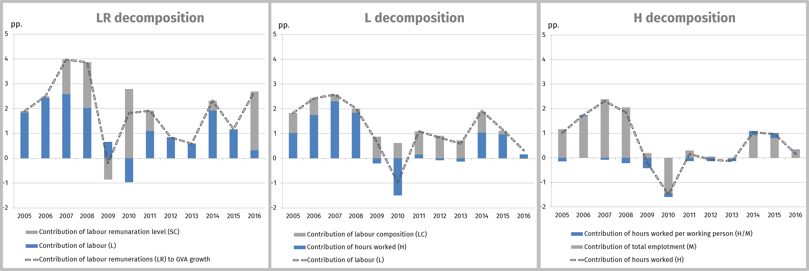
Part II Basic and specific results:
Reduced remunerations delayed the reduced contribution of labour (related with the layoffs)
…which was accompanied by labour hoarding,
i.e. the reduced hours worked per employee (in blue) without decreases in the number of employees (in grey)

Slide 26
Part II Basic and specific results:
Lastly, a Gross Output decomposition into intermediate input and factor contribution has been performed:
This allowed to identify two periods in the Polish economy in the covered (2005-2016) span of time:
A transformation period until 2011 and
A stabilization period after 2011

Slide 27
Part II Basic and specific results:

Slide 28
Part II Basic and specific results:
After 2011 changes related to factor substitution by intermediate inputs have ceased

Slide 29
Part II Basic and specific results:
…i.e. outsourcing growth (and additionally changes in some capital being treated as intermediate consumption) has ceased

Slide 30
Part III
Analysis related to Middle-Income Trap

Slide 31
Part III Analysis related to Middle-Income Trap:
Cumulative data related to GVA growth indicate that in the analyzed period Czech Republic, and particularly Slovakia and Poland have been catching up with the other western KLEMS countries

Slide 32
Part III Analysis related to Middle-Income Trap:
In case of Slovakia and Poland this convergence process continued in the post-crisis growth reconstruction period

Slide 33
Part III Analysis related to Middle-Income Trap:
The GVA growth decomposition indicates that at the aggregate level the contribution of capital (capital services) is domineering.
Its contribution even strengthened in relative terms after the crisis

Slide 34
Part III Analysis related to Middle-Income Trap:
However, for Poland according to NACE sections, this high contribution of capital (capital services) is associated with transport (H), energy and other networks (D-E) and culture (R), and sections not belonging to the so called market economy (L, O, P, Q).

Slide 35
Part III Analysis related to Middle-Income Trap:
I.e. it can be associated with public and infrastructural capital growth

Slide 36
Part III Analysis related to Middle-Income Trap:
For the remaining sections MFP contribution prevails.
Particularly in the NACE manufacturing section C and information section J the contribution of MFP is the greatest.
This indicates a reindustrialization and a digitalization of the Polish economy

Slide 37
Part III Analysis related to Middle-Income Trap:
After the crisis the importance of NACE section J even increased in relative terms
As a general rule, the faster MFP grows the faster GVA grows as well

Slide 38
Part III Analysis related to Middle-Income Trap:
As a general rule, the faster MFP grows the faster GVA grows as well
…the growth engine of the economy is therefore MFP driven, not capital driven…

Slide 39
Part III Analysis related to Middle-Income Trap:
It is intended to perform a KLEMS growth accounting by 16 Polish voivodships, but this turn requires solving some methodological problems
However, a simpler classical decomposition of Solow type was already performed by voivodships

Slide 40
Part III Analysis related to Middle-Income Trap:
It can be seen that voivodships developing quicker than average are those with higher MFP contributions
This confirms to some degree the previous findings !!

Slide 41
Access to data: https://stat.gov.pl/en/experimental-statistics/klems-economic-productivity-accounts

