Slide 1
MULTIDIMENSIONAL POVERTY IN RUSSIAN REGIONS
Nikita Ryabushkin, SERGEY KAPELYUK
Siberian University of consumer cooperation
Sergey Kapelyuk is grateful to the RFBR for the financial support under the research project № 18-010-01180
Nikita Ryabushkin is thankful to the RFBR and the Government of Novosibirsk Oblast for the financial support according to the research project № 19-410-543002

Slide 2
Motivation
The poverty rate is among the main development indicators.
The assessment of poverty rate is important for comparison of within-country regions.
Traditionally poverty is measured by income or consumption. It is a one-dimensional approach.
Recent research has demonstrated the limitations of this approach.
The main advantage of the multidimensional poverty index (MPI) is the accounting for the deprivation in access to various basic needs.
Multidimensional poverty is closer to chronic poverty than the income poverty that primarily consists of transitory poverty

Slide 3
Aims and contribution
Purpose | To calculate the multidimensional poverty indicators for Russian regions and population groups
Contribution | To the best of our knowledge, it is a first attempt to calculate multidimensional poverty index for all regions of the Russian Federation.
The purpose of this study is

Slide 4
The most remarkable results
The interregional inequality in Russia is much higher compared to Rosstat data.
For some regions (for example, the Altai Republic, Belgorod Oblast) results of our calculations considerably differ from the official statistics data.
From 2014 to 2016, the multidimensional poverty rate decreased in many regions of the Russian Federation, while the income poverty rate increased.
Pensioners and those living alone have the highest risk of poverty that considerably contradicts with the Rosstat data.

Slide 5
“Official” poverty measurement in Russia
Absolute monetary approach.
Poverty determination uses (i) the mean income calculated on the macroeconomic data and (ii) the income distribution obtained by the household budget survey.
The household budget survey does not measure income directly but only collects data on monetary consumption and net savings which are used to calculate monetary income.
The main poverty measure is a headcount index (poverty rate).
It is determined as a percentage of the population with monetary income lower than the poverty line.
The poverty line is the monthly subsistence minimum.
No adjustment for the household economies of scale.

Slide 6
Drawbacks
Ignoring the rental value of dwellings for homeowners (Ovtcharova and Tesliuk, 2006).
Significant household economy of scale (Lokshin et al., 2000; Spryskov, 2003; Denisova, 2012; Abanokova and Lokshin, 2014).
Inconsistency of poverty lines across different regions (Ravallion and Lokshin, 2003, 2006).
The dynamics of the relative poverty measure differs from the dynamics of the absolute poverty measure (Litvintseva et al., 2007; Denisova, 2012).
Inaccurate measurement of net savings (World Bank, 2005).
Highly differentiated weights (World Bank, 2005).
The real income distribution in Russia is far from the log-normal (Aivazian and Kolenikov, 2001, Sheviakov and Kiruta, 2001; Kolmakov, 2008).

Slide 7
Alternative results
Mroz and Popkin (1995) argue that the significant part of those considered by the official measure to be poor is not really poor.
Ferrer-i-Carbonell and Van Praag (2001) receive the estimates much higher than the official estimate.
Abanokova and Lokshin (2014) show that after the economy-on-scale adjustment the poverty profile significantly changes.
Lokshin and Yemtsov (2013) show the high diversity of the alternative estimates.

Slide 8
Previous studies
Worldwide (Alkire and Santos, 2010; UNDP Human Development Report, 2010; Oxford Poverty and Human Development Initiative, 2017).
988 regions in 78 countries, Russia not included (Oxford Poverty and Human Development Initiative, 2017)
European Union (Alkire, and Apablaza, 2016)
Latin America (Santos and Vilatoro, 2018)
China (Yu, 2011)
India (Banerjee, Chaudhuri, Montier, and Roy, 2014)
Indonesia (Ballon, and Apablaza, 2012)
Malaysia (Ibrahin, Husain, and Rahman, 2011)

Slide 9
Table 1. Main dimensions of multidimensional poverty
Countries | Education | Health | Living conditions | Income | Security | Services
Worldwide (UNDP) | + | + | +
EU (Alkire, and Apablaza, 2016) | + | + | + | +
China (Yu, 2011) | + |  | + | + | +
India (Banerjee, Chaudhuri, Montier, and Roy, 2014) | + |  | + | +
Indonesia (Ballon, and Apablaza, 2012) | + | + |  |  |  | +
The Russian Federation | + | + | +

Slide 10
Data
The 2nd and 3rd waves of the Comprehensive Monitoring of Living Conditions of the Population.
The survey is carried out by the Federal State Statistics Service of the Russian Federation (Rosstat) in 2014 and 2016.
The 2nd wave covered 136,232 individuals from all regions of Russia.
The 3rd wave covered 134,852 individuals from all regions of Russia.

Slide 11
Methodology
Each person in a household is defined as poor or not poor depending on the quantity of deprivations, which she faces in the household.
Our modification also uses three dimensions of MPI as the original index: education, health, and living conditions.
However, we change the list of deprivations in each dimension.

Slide 12
Methodology
Deprivation in living conditions:
problems with hot and cold water supply,
bad accommodation conditions,
living in communal apartments,
problems with the electric power,
poor quality of water from an available source,
inappropriate heating type,
poor self-evaluation of current financial position,
lack of resources to buy medical drugs,
income below the poverty line.
Deprivation in education:
primary education or less,
the number of years of education less than 5 years,
no school attendance for children 7-16 years old.
Deprivation in health:
self-assessment of health as poor,
chronic diseases,
disability,
lack of access to medical care.

Slide 13
How to calculate the multidimensional poverty index
The dimension “education”
Poverty by education=Х1*1.111+Х2*1.111+Х3*1.111
The dimension “health”
Poverty by health= Y1*0.833+Y2*0.833+Y3*0.833+Y4*0.833
The dimension “living conditions”
Poverty by living conditions = Z1*0.33+Z2*0.33+Z3*0.33+Z4*0.33+Z5*0.33+
+Z6*0.33+Z7*0.33+Z8*0.33+Z9*0.33+Z10*0.33
The weighted number of deprivations (C)
C=Poverty by education+ Poverty by health+ Poverty by living conditions

Slide 14
How to calculate the multidimensional poverty index
Determination of poor
households
Poor = 1 if C >=3
Non Poor = 0 if C < 3
Multidimensional poverty rate (H)
Percentage of poor households
Poverty intensity (I)
Mean number of deprivations in poor households
Multidimensional poverty index (MPI)
MPI = H × I

Slide 15
Figure 1. Income poverty and multidimensional poverty rate
The Republic Of Altai
Karachay – Cherkess Republic
Республика Алтай

Slide 16
Figure 2. Income poverty and multidimensional poverty index
Karachay – Cherkess Republic
The Republic Of Altai
Yamalo - Nenets Autonomous Okrug

Slide 17
Comparison with other studies
Study | Countries | Minimum | Maximum | Standard deviation
OPHI, 2017 | Developing countries | Kazakhstan (0.0002) | Niger (0.61) | 0.17
OPHI, 2017 | Nigeria | Lagos (0.04) | Yobe (0.64) | 0.19
OPHI, 2017 | Brazil | Distrito Federal (0.01) | Acre (0.07) | 0.01
Alkire and Apablaza, 2016 | European Union | Iceland (0.01) | Greece (0.10) | 0.02
Alkire and Seth, 2015 | India | Kerala (0.04) | Bihar (0.42) | 0.10
Banerjee et al., 2014 | India | Delhi (0.05) | Bihar (0.45) | 0.11
Yu, 2013 | China | Liaoning (0.004) | Guizhou (0.05) | 0.02
Statistics South Africa, 2014 | South Africa | Western Cape (0.02) | Eastern Cape (0.06) | 0.01
Our results | The Russian Federation | Moscow (0.02) | Republic Altai (0.22) | 0.04

Slide 18
Multidimensional poverty rate compared to official poverty rate
Source: calculated by authors on the CMLC data for 2014

Slide 19
Table 1. Comparison of the HBS and the CMLC poverty estimates
 | Official Rosstat data | Poverty by income (indirect approach) | Poverty by consumption | Poverty by income (direct question) | Poverty by income (direct question) | Multidimensional poverty
 | based on HBS | HBS | HBS | HBS | CMLC | CMLC
 | 2014 | 2014 Q3 | 2014 Q3 | 2014 Q3 | 2014 Q3 | 2014 Q3
 | (2) | (3) | (4) | (5) | (6) | (7)
Poverty rate |  | 0.298 | 0.461 | 0.276 | 0.269 | 0.228
Poverty rate, weighted estimate | 0.112 | 0.211 | 0.339 | 0.242 | 0.234 | 0.210
Proportion of urban dwellers among poor |  | 0.502 | 0.532 | 0.475 | 0.498 | 0.545
Proportion of urban dwellers among poor, weighted estimate | 0.611 | 0.609 | 0.621 | 0.604 | 0.531 | 0.595
Notes: the column (2) presents Rosstat data, columns (3)–(7) present the authors’ calculations based on HBS and CMLC data.

Slide 20
Multidimensional poverty rate compared to official poverty rate
Source: calculated by author on the CLMC data

Slide 21
Multidimensional poverty rate compared to official poverty rate
Source: calculated by authors on the CLMC data

Slide 22
Table 2. Poverty estimates by age groups
 | Official income poverty rate | Income poverty rate | Multi-dimensional poverty rate H | Poverty intensity A | Multidimensional poverty index MPI
 | Rosstat | CMLC | CMLC | CMLC | CMLC
 | (2) | (3) | (4) | (5) | (6)
Total population | 0.112 | 0.269 | 0.228 | 0.438 | 0.100
By age groups:
Under 16 years old | 0.185 | 0.451 | 0.171 | 0.417 | 0.071
16-30 years old | 0.110 | 0.300 | 0.152 | 0.429 | 0.065
Men 31-59 years old, and women 31-54 years old | 0.117 | 0.258 | 0.184 | 0.430 | 0.079
Men 60 years and older, and women 55 years and older | 0.053 | 0.148 | 0.369 | 0.453 | 0.167
Notes: the column (2) presents Rosstat data for 2014, columns (3)–(6) present the authors’ calculations based on CMLC data.

Slide 23
Table 3. Distribution of poor by type and size of settlement
 | Official income poverty rate | Income poverty rate | Multidimensional poverty rate H
 | Rosstat | CMLC | CMLC
 | (2) | (3) | (4)
Urban settlements | 0.611 | 0.498 | 0.545
One million and more | 0.094 | 0.037 | 0.068
250,000 – 999,999 | 0.078 | 0.069 | 0.102
100,000 – 249,999 | 0.081 | 0.058 | 0.066
50,000 – 99,999 | 0.084 | 0.076 | 0.070
Less than 50,000 | 0.274 | 0.251 | 0.248
Rural settlements | 0.389 | 0.502 | 0.455
5,000 and more | 0.100 | 0.093 | 0.084
1,000 – 4,999 | 0.177 | 0.203 | 0.172
200 – 999 | 0.107 | 0.202 | 0.179
Less than 200 | 0.005 | 0.012 | 0.011
Notes: the column (2) presents Rosstat data for 2014, columns (3)–(4) present the authors’ calculations based on CMLC data.

Slide 24
Table 4. Distribution of poor by labor force participation and employment status (only for individuals aged 15 and older)
 | Official income poverty rate | Income poverty rate | Multidimensional poverty rate H
 | Rosstat | CMLC | CMLC
 | (2) | (3) | (4)
Panel A
In labor force | 0.644 | 0.492 | 0.337
Employed | 0.628 | 0.470 | 0.326
Registered unemployed | 0.016 | 0.022 | 0.011
Out of labor force | 0.356 | 0.508 | 0.663
Pensioners | 0.120 | 0.283 | 0.581
Non-pensioners | 0.236 | 0.225 | 0.082
Panel B
In labor force | … | 0.576 | 0.388
Employed | 0.628 | 0.470 | 0.326
All unemployed | … | 0.106 | 0.062
Out of labor force | … | 0.424 | 0.612
Pensioners | … | 0.246 | 0.542
Non-pensioners | … | 0.178 | 0.070
Notes: the column (2) presents Rosstat data for 2014, columns (3)–(4) present the authors’ calculations based on CMLC data.
.

Slide 25
Table 5. Distribution of poor by household size
 | Official income poverty rate | Income poverty rate | Multidimensional poverty rate H
 | Rosstat | CMLC | CMLC
 | (2) | (3) | (4)
1 person | 0.031 | 0.050 | 0.147
2 person | 0.151 | 0.156 | 0.320
3 person | 0.253 | 0.216 | 0.198
4 person | 0.322 | 0.295 | 0.161
5 person and more | 0.243 | 0.284 | 0.175
Notes: the column (2) presents Rosstat data, columns (3)–(7) present the authors’ calculations based on HBS and CMLC data.

Slide 26
Table 6. Distribution of poor by presence and number of children in household
 | Official income poverty rate | Income poverty rate | Multidimensional poverty rate H
 | Rosstat | CMLC | CMLC
 | (2) | (3) | (4)
Without children | 0.371 | 0.272 | 0.624
With children | 0.629 | 0.728 | 0.376
1 child | 0.307 | 0.273 | 0.183
2 children | 0.236 | 0.300 | 0.127
3 and more | 0.086 | 0.155 | 0.066
Notes: the column (2) presents Rosstat data, columns (3)–(7) present the authors’ calculations based on HBS and CMLC data.

Slide 27
Table 7. Regression estimates
 | Dependent variable – income poverty | Dependent variable – multidimensional poverty | Dependent variable – poverty intensity
 | (2) | (3) | (4)
Age | baseline category – 0-14 years old
15-19 years | 0.021*** (0.005) | 0.019*** (0.006) | 0.007*** (0.003)
20-29 years | 0.103*** (0.004) | 0.032*** (0.005) | 0.007*** (0.003)
30-39 years | 0.087*** (0.004) | 0.080*** (0.004) | 0.015*** (0.002)
40-49 years | 0.097*** (0.005) | 0.100*** (0.005) | 0.021*** (0.003)
50-59 years | 0.107*** (0.005) | 0.151*** (0.005) | 0.023*** (0.003)
60-69 years | 0.066*** (0.006) | 0.190*** (0.006) | 0.026*** (0.003)
70-79 years | 0.038*** (0.007) | 0.275*** (0.006) | 0.037*** (0.003)
80 years and older | -0.045*** (0.009) | 0.331*** (0.008) | 0.060*** (0.004)

Slide 28
Table 7. Regression estimates (cont.)
 | Dependent variable – income poverty | Dependent variable – multidimensional poverty | Dependent variable – poverty intensity
 | (2) | (3) | (4)
Highest education degree | baseline category – higher education
unfinished higher | 0.100*** (0.008) | 0.026*** (0.009) | -0.014*** (0.004)
vocational, specialized secondary | 0.120*** (0.003) | 0.070*** (0.003) | 0.007*** (0.001)
secondary | 0.164*** (0.003) | 0.074*** (0.003) | 0.014*** (0.002)
less than secondary | 0.155*** (0.007) | 0.463*** (0.008) | 0.160*** (0.003)
Job (1 – employed, 0 – non-employed) | -0.134*** (0.003) | -0.117*** (0.003) | -0.021*** (0.002)
Old-age pension (1 – pensioner, 0 – non-pensioner) | -0.079*** (0.004) | -0.054*** (0.004) | -0.020*** (0.002)

Slide 29
Table 7. Regression estimates (cont.)
 | Dependent variable – income poverty | Dependent variable – multidimensional poverty | Dependent variable – poverty intensity
 | (2) | (3) | (4)
Number of children in household | baseline category – no children in household
1 child | 0.146*** (0.003) | -0.016*** (0.003) | -0.014*** (0.002)
2 children | 0.275*** (0.003) | -0.004*** (0.004) | -0.014*** (0.002)
3 children | 0.414*** (0.005) | 0.037*** (0.006) | -0.009*** (0.003)
4 children and more | 0.474*** (0.011) | 0.085*** (0.009) | -0.006*** (0.005)

Slide 30
Table 7. Regression estimates (cont.)
 | Dependent variable – income poverty | Dependent variable – multidimensional poverty | Dependent variable – poverty intensity
 | (2) | (3) | (4)
Number of adults in household | baseline category – one adult
2 adults | -0.002*** (0.003) | 0.059*** (0.003) | 0.029*** (0.001)
3 adults | 0.058*** (0.003) | 0.149*** (0.004) | 0.063*** (0.002)
4 adults and more | 0.116*** (0.004) | 0.217*** (0.004) | 0.077*** (0.002)
Arctic zone (1 – arctic zone, 0 – other regions) | -0.057*** (0.007) | -0.037*** (0.007) | 0.001*** (0.004)

Slide 31
Table 7. Regression estimates (cont.)
 | Dependent variable – income poverty | Dependent variable – multidimensional poverty | Dependent variable – poverty intensity
 | (2) | (3) | (4)
Federal district | baseline category – Central federal district
Northwestern | 0.010*** (0.004) | 0.002*** (0.004) | -0.001*** (0.002)
Volga | 0.037*** (0.003) | -0.001*** (0.003) | -0.000*** (0.002)
Southern | 0.085*** (0.004) | 0.023*** (0.004) | 0.003*** (0.002)
North Caucasusian | 0.103*** (0.004) | 0.015*** (0.004) | 0.002*** (0.002)
Ural | 0.063*** (0.004) | 0.003*** (0.004) | 0.002*** (0.002)
Siberian | 0.119*** (0.003) | 0.073*** (0.003) | 0.012*** (0.002)
Far Eastern | 0.094*** (0.005) | 0.021*** (0.005) | -0.007*** (0.002)

Slide 32
Table 7. Regression estimates (cont.)
 | Dependent variable – income poverty | Dependent variable – multidimensional poverty | Dependent variable – poverty intensity
 | (2) | (3) | (4)
Type of settlement | baseline category – big city
medium city | 0.071*** (0.005) | 0.066*** (0.004) | 0.008*** (0.002)
small city | 0.157*** (0.004) | 0.086*** (0.004) | 0.011*** (0.002)
big village | 0.178*** (0.005) | 0.124*** (0.005) | 0.018*** (0.003)
medium village | 0.249*** (0.004) | 0.154*** (0.004) | 0.024*** (0.002)
small village | 0.298*** (0.004) | 0.167*** (0.004) | 0.026*** (0.002)
R-squared | – | – | 0.27
Pseudo R-squared | 0.27 | 0.17 | –
Number of observations | 136,232 | 136,232 | 31,013

Slide 33
Multidimensional poverty rate compared to official poverty rate
Source: calculated by authors on the CLMC data

Slide 34
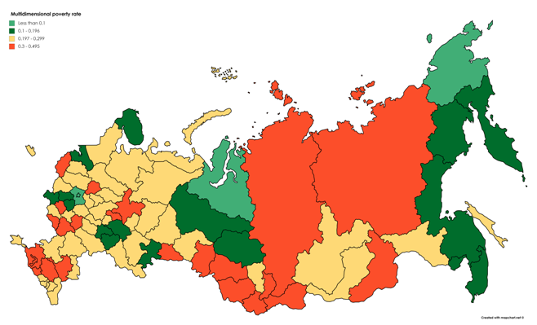
The map of multidimensional poverty rate in the Russian Federation 2014

Slide 35
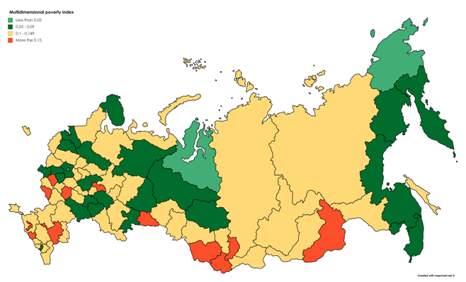
The map of multidimensional poverty index in the Russian Federation 2014

Slide 36
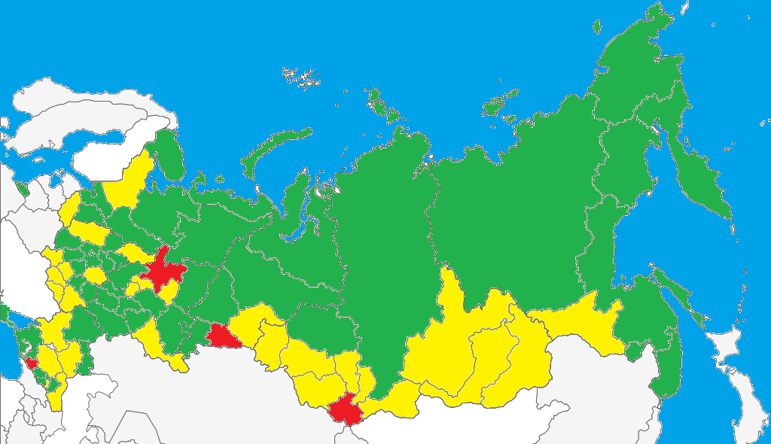
The map of multidimensional poverty in the Russian Federation 2016
<10%
10%-15%
>15%

Slide 37
The most remarkable results
The interregional inequality in Russia is much higher compared to Rosstat data.
For some regions (for example, the Altai Republic, Belgorod Oblast) results of our calculations considerably differ from the official statistics data.
From 2014 to 2016, the multidimensional poverty rate decreased in many regions of the Russian Federation, while the income poverty rate increased.
Pensioners and those living alone have the highest risk of poverty that considerably contradicts with the Rosstat data.

Slide 38
Future research
Using RLMS-HSE data.
Decomposition of changes in multidimensional poverty indicators.
Comparison with subjective well-being data.
Robustness checks.

Slide 39
Thank you for attention
Nikita Ryabushkin
bakster154@gmail.com
www.facebook.com/nryabushkin
Sergey Kapelyuk
skapelyuk@bk.ru

