Slide 1
Review of Erumban et al.
“…An India-Russia Comparison”
Barbara M. Fraumeni
China Center for Human Capital and Labor Market Research
Central University of Finance and Economics, Beijing, China
CEFMS, Hunan University, Changsha, China
National Bureau of Economic Research, Cambridge, MA USA
IZA, Bonn, Germany

Slide 2
Components
Gross value added, number of employees (FTE), capital services, and capital shares available for both countries
For Russia, “capital services from each asset is proportional to the average of the stock available at the end of the current and prior period”

Slide 3
Aggregate MFP
Aggregate economy MFP is computed as the sum of sectoral growth rates weighted using their nominal share
How much different would the answer be if an aggregate production function was used?

Slide 4
How Do I Critique This Paper?
Uses data and decomposition of growth methodology I strongly favor
Presents results with some interpretation, but emphasis is on the results
Solid data base contribution

Slide 5
Figure 1

Slide 6
Presentation Comments
Combine figure 1 and 2
Employment, capital deepening, and TFP contributions to VA growth
Employment and capital deepening the link between labor productivity and TFP
Otherwise I kept going between the two graphs to get the whole picture
Flip bars to vertical

Slide 7
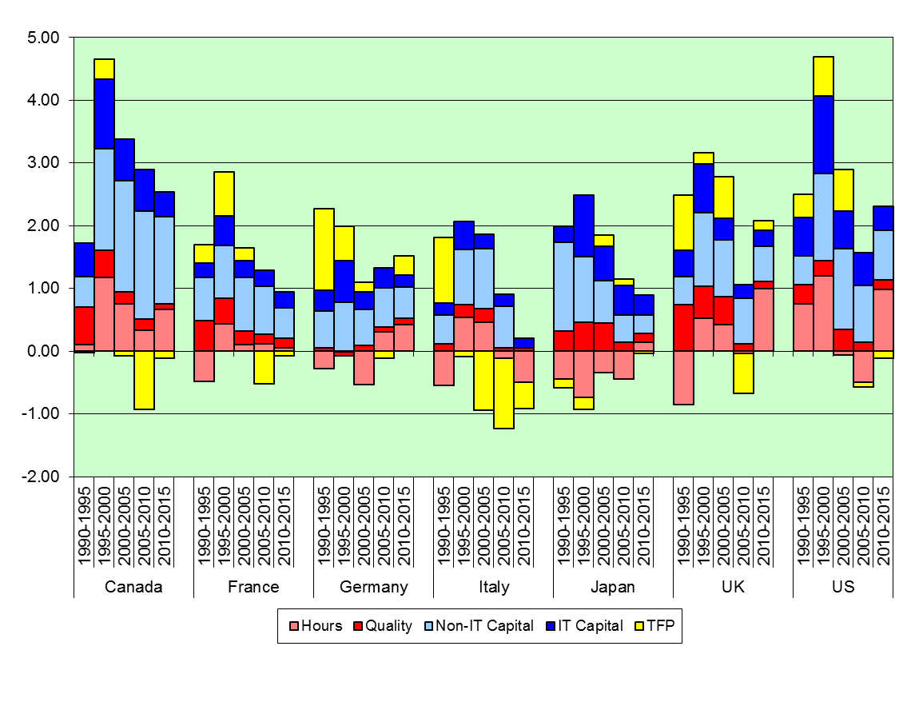
Sources of G7 Economic Growth

Slide 8
Summaries
Bring conclusion summaries into the body of the paper to help avoid number fatigue
Can repeat these to some extent in the conclusion

Slide 9
Figure 3 for India

Slide 10
More Figures Like Figures 3
For table 4, show industry and services above and below averages, probably both countries on the same graph, one for each subperiod

Slide 11
Might Not Work!
But somehow you need to keep your audience from suffering from number overload
Estimates done, just presentation work to be completed

