Slide 1
Opportunities for Human Capital Measurement
IARIW, Dresden, Germany
August 26, 2016
Barbara M. Fraumeni
China Center for Human Capital and Labor Market Research
Central University of Finance and Economics, Beijing, China
Center for Economics, Finance, and Management Studies, Hunan University, Changsha, China
National Bureau of Economic Research, Cambridge, MA USA
Muskie School, University of Southern Maine, Portland, USA

Slide 2
Dresden, Maine, USA

Slide 3
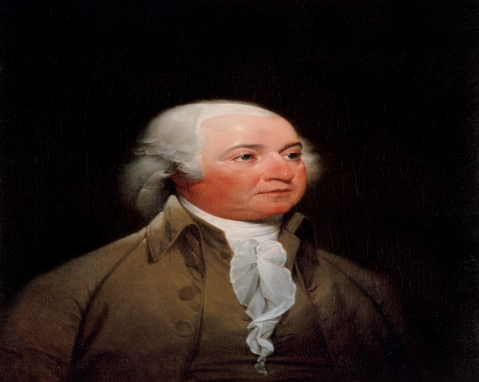

Slide 5
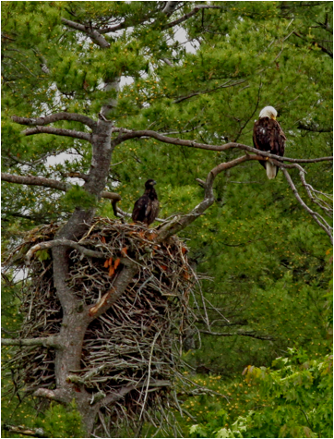

Slide 7
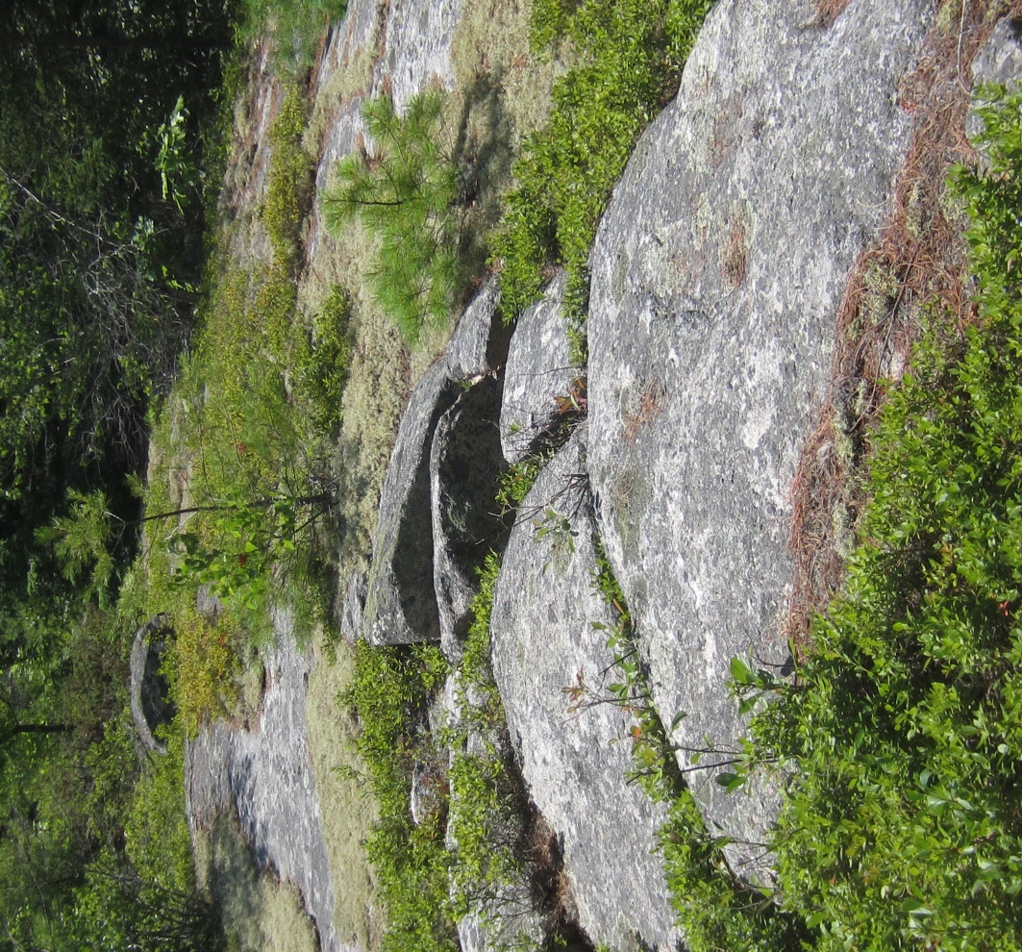

Slide 8
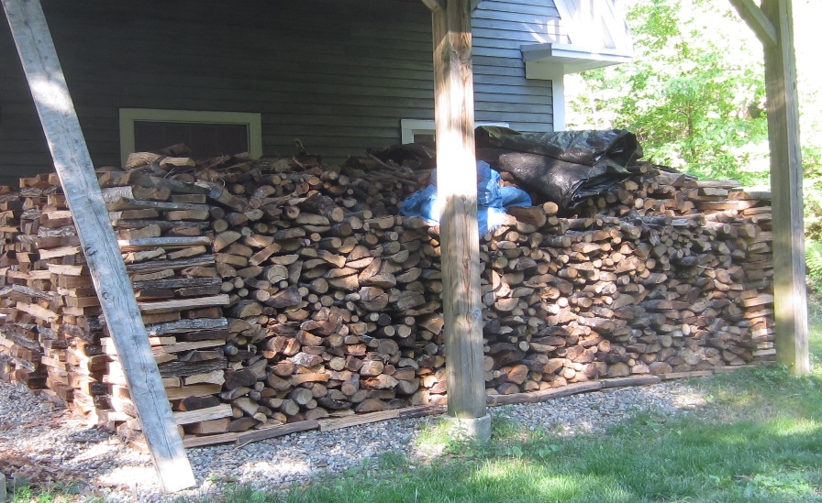

Slide 9
Human Capital

Slide 10
Context Interest in Human Capital
Stiglitz-Sen-Fitoussi Commission 2008-9
“Beyond GDP”
Wealth estimates
World Bank 2006, 2011
Inclusive Wealth Report 2014
OECD Human Capital project – Liu (2011)
UNECE Task Force (TF) on Human Capital
Draft report January 2016

Slide 11
Jorgenson-Fraumeni
A monetary, lifetime income approach
Exists for some 20 countries
Used for China by CHLR/CUFE
My analysis in the educational attainment gap and rankings NBER working paper relies on the OECD human capital project results (Liu, 2011), estimates for China (Li, 2013) and India (Gundimeda, 2007)
18 countries

Slide 12
Jorgenson-Fraumeni
Jorgenson, D. W. & Fraumeni, B. M. (1989) “The Accumulation of Human and Nonhuman Capital, 1948-1984,” in Lipsey, R. and Tice, H. (eds). The Measurement of Saving, Investment and Wealth. Chicago: University of Chicago Press, NBER, pp. 227-282.
Jorgenson, D. W. & Fraumeni, B. M. (1992) “Investment in Education and U.S. Economic Growth,” Scandinavian Journal of Economics, 94 (Supplement), pp. S51-70.
Jorgenson, D. W. & Fraumeni, B. M. (1992) “The Output of the Education Sector,” in Griliches, Z., Breshnahan, T., Manser, M. & Berndt, E. (eds), The Output of the Service Sector, Chicago: University of Chicago Press, NBER, pp. 303-341.

Slide 13
Jorgenson-Fraumeni
Liu, Gang (2011) “Measuring the Stock of Human Capital for Comparative Analysis: An Application of the Lifetime Income Approach to Selected Countries,” OECD Statistics Directorate, Working Paper #41, STD/DOC(2011)6, October 10.
For China: Li, H., Principal Investigator, (2013), “Human Capital in China,” China Center for Human Capital and Labor Market Research, Central University of Finance and Economics, Beijing, China, December.
For India: Gundimeda, H., S. Sanyal, R. Sinha, and P. Sukhdev (2007), “Estimating the Value of Educational Capital Formation in India,” Monograph 5, GAISP (Green Accounting for Indian States Project), TERI Press, New Delhi, India, March.
For Japan: These results were obtained directly from Gang Liu.

Slide 14
Jorgenson-Fraumeni
Fraumeni, Barbara M., Michael S. Christian and Jon D. Samuels (2015) “Accumulation of Human and Nonhuman Capital, Revisited,” forthcoming, Review of Income and Wealth, previous version NBER Working Paper 21284, June.
Fraumeni, Barbara M. (2015) “Choosing a Human Capital Measure: Educational Attainment Gaps and Rankings,” NBER Working Paper 21283, June.
Christian, Michael S. (2015) “Net Investment and Stocks of Human Capital in the United States, 1975-2013, draft.

Slide 15
Jorgenson-Fraumeni
The J-F lifetime income approach applies the neoclassical theory of investment (Jorgenson, 1967) to human capital.
According to this theory, the price of capital goods depends upon the discounted value of all future capital services derived from the investments.
On a per capita basis, this means that the value of the human capital of an individual can be determined from that person’s discounted lifetime income.

Slide 16
Jorgenson-Fraumeni
The following sets of data for a J-F simplified approach (Fraumeni 2008) as implemented by Liu (2011) are required, except as noted for ages 15 through 64, and gender
1) working age population,
2) survival rates,
3) school enrollment rates for ages 15 through 29 by single year, ages 30-34 and 35-39 by five year categories, and 40 and above,
4) educational attainment, and
5) annual earnings.

Slide 17
Jorgenson-Fraumeni
3 life stages, with variables
mi: Expected lifetime market income per capita, discounted to the present
R: The adjustment factor applied to lifetime income
= (1 + real rate of growth on labor income)/(1 + real discount rate)
sr: Survival rate
senr: Formal school enrolment rate and
ymi: Yearly market income per capita.
For subscripts:
a: Age
e: Highest level of education completed
enr: Formal education enrollment level
older: Equal to a + 1
s: Gender, and
school: Equal to e +1.

Slide 18
Jorgenson-Fraumeni
Stage 1: Work and school, ages 15 through 40, when an individual could be enrolled in school
mi(s,a,e)=ymi(s,a,e)+
[senr(s,a,enr)*sr(s,older)*mi(s,older,school)
+(1-senr(s,a,enr))*sr(s,older)*mi(s,older,e)]*R

Slide 19
Jorgenson-Fraumeni
Stage 2: Work only, ages 41 through 64 when it is assumed that an individual is not enrolled in school
mi(s,a,e)=ymi(s,a,e)+sr(s,older)*mi(s,older,e)*R
Stage 3: Retirement, age 65 and over
mi(s,a,e)=0

Slide 20
Jorgenson-Fraumeni
Recursive backwards calculations
Assumed that the relative wage rates by educational attainment levels are determined by the contemporaneous relative wage rates, survival rates, and enrollment rates

Slide 21
NOT representing the World Bank in this presentation

Slide 22
Opportunity – I2D2
World Bank International Income Distribution Data Base (I2D2)
Only available to someone with a World Bank email
Covers at least 160 countries
Includes information from over 950 surveys
Earliest 1980, some for 2013 (or later as it is updated)
Harmonized
Nationally representative
Weights available

Slide 23
Opportunity – I2D2
Includes demographic, education, labor force and other variables
Currently housed in the World Bank’s Poverty & Inequality Unit
Data not necessarily clean
Early description
Montenegro, Claudio E., and Maximilian Hirn. (2009) "A New Disaggregated Set of Labor Market Indicators using Standardized Household Surveys from around the World," World Bank.

Slide 24
Opportunity Montenegro & Patrinos
Montenegro, Claudio O. and Harry Anthony Patrinos (September 2014) “Comparable Estimates of Returns to Schooling Around the World,” World Bank Policy Research Working Paper #7020.
Two versions of Mincer semilog equations
With # of years of education
With dummies for level of education achieved
Both with the natural log of earnings as the dependent variable

Slide 25
Opportunity Montenegro & Patrinos
Both types of Mincers have potential experience and potential experience squared as variables, with potential experience = (age – years of schooling – 6)
Ages 15-65, wage and salary workers only
Significantly more countries and surveys for single year of school equation and lower standard deviations

Slide 26
Montenegro & Patrinos Results
Returns to schooling averaged about 10%
On average higher for females than for males, for both forms of the equation (eqn. 1: 11.7% vs. 9.6%)
Overall averages
Primary: 10.6%
Secondary: 7.2%
Tertiary: 15.2%
Returns differed significantly by country

Slide 27
Proof of Concept – Chile 2009
Allows for the construction of a modified Jorgenson-Fraumeni for a large number of countries
Modified as using Mincers
Based on years of schooling equation to maximize number of countries covered

Slide 28
Proof of Concept – Chile 2009
Proof of concept was part of the CWON effort
World Bank (2006) Where is the Wealth of Nations: Measuring Capital for the 21st Century, Washington, DC: World Bank.
World Bank (2011)The Changing Wealth of Nations: Measuring Sustainable Development in the New Millennium, Washington, D.C: World Bank.

Slide 29
Proof of Concept
Proof of concept exercise demonstrated that Jorgenson-Fraumeni could be implemented for a large number of countries
A representative country approach would be needed to cover some number of the target 140 countries
Also, results have to be generated for years in which a survey is not available, allowing for changes such as changes in educational attainment

Slide 30
Challenges
Extending estimates to include:
Self-employed
Informal economy
Control totals
Often by broad, labor force participation, age and gender categories
Definitions of available control totals may differ from country to country

Slide 31
Educational Attainment Gaps

Slide 32
2010 Country Distribution Of Educational Attainment Gains (55-64 to 25-34 %)
Percent | Adv. | E. Asia & Pacific | Europe & Central Asia | Latin Amer. & Caribe | Middle E. & N. Africa | S. Asia | Sub Saharan Africa | Avg. Ed. of Younger
≤500 to >100% | 0 | 2 | 0 | 1 | 4 | 3 | 11 | 6.13
≤100 to >50% | 1 | 4 | 0 | 6 | 2 | 1 | 8 | 8.04
≤ 50 to >20% | 6 | 6 | 1 | 6 | 3 | 1 | 3 | 10.75
≤20 to 0% | 9 | 1 | 9 | 3 | 1 | 0 | 1 | 11.60
≤0% | 1 | 0 | 4 | 1 | 1 | 0 | 0 | 10.49
Country No. | 24 | 19 | 20 | 25 | 17 | 7 | 33 | 9.36

Slide 33
Gap Table Source
Robert J. Barro and Jong-Wha Lee (2013) “Barro-Lee Educational Attainment Data Set” version 2.1, dated February 2016.

Slide 34
U.S. HC Productivity to MFP Deepening Analysis
Standard equation relates labor productivity to MFP via a capital deepening term
This analysis relates HC productivity to MFP with three new terms:
Market labor deepening
Labor time in household and production and leisure deepening
Nonhuman capital deepening
All deepening relative to HC

Slide 35
New Deepening Equation
ln(O(t)/L_{HC}(t))-ln((O(t-1)/L_{HC}(t-1)) =
V_{LM}(t)*[ln(L_{M}(t)/L_{HC}(t)) - ln(L_{M}(t-1)/L_{HC}(t-1))] +
V_{LT}(t)*[ln(L_{T}(t)/L_{HC}(t)) - ln(L_{T}(t-1)/L_{HC}(t-1))]
V_{K}(t)*[ln(K(t)/L_{HC}(t)) - ln(K(t-1)/L_{HC}(t-1))] +
ln(MFP(t)) - ln(MFP(t-1)),

Slide 37
Graph from
Barbara M. Fraumeni, “Human Capital Productivity,” draft for a chapter in Productivity Dynamics in Developed and Emerging Economies, a volume being edited by Deb Kusum Das in honor of Professor K L Krishna
Data from
Fraumeni, Barbara M., Michael S. Christian, and Jon D. Samuels (forthcoming) “The Accumulation of Human and Non-Human Capital, Revisited”
forthcoming, Review of Income and Wealth

Slide 39
Results
When multifactor productivity change is the greatest contributor to economic growth: 1950-1973 and 1999-2000, nonhuman capital deepening is the second largest contributor
In the other sub periods, time in household production and leisure labor outlay deepening is in the top two
In 1974-84 and 2001-5, time deepening is the largest contributor followed by nonhuman capital deepening
In 2006-9, market labor deepening is the largest followed by time deepening

Slide 40
Results
The rate of growth of human capital is highest in 1950-84
The pace of increases in the average educational attainment of worker-aged individuals slowed in the U.S. in about 1980
Increases in female labor force participation continued until the mid-nineties
According to the US BLS and AAUW, the median gender pay gap decreased by 20 percentage points between mid to late 70’s and mid-2000’s

Slide 41
Results
Between 1965 and 2010, actual time spent in household production
By women decreased by 35 percent
By men increased by 23 percent.
Net effect was a 15 percent decrease
Bridgman, B., A. Dugan, M. Lal, M. Osborne, and S. Villones. 2012. ‘Accounting for Household Production in the National Accounts, 1965–2010’, Survey of Current Business. Washington, D.C.: Bureau of Economic Analysis, U.S. Department of Commerce, May.
Decreased female time in HH production may be offset by increases in the value of female time

Slide 42
Results
More needs to be done to analyze the deepening results, but directional clues are abundant

Slide 43
Continuing Research
More than enough fodder for future research
Deepening investigation
Hopefully the World Bank project to estimate J-F for a large number of countries will be funded
Implications of the increasing education levels of younger vs. older workers (and of countries having populations with continuing very low education levels) for future economic growth

